Slide 1
Consciousness and epilepsy
Seizures with altered, reduced, enhanced and fractionated consciousness.
Bernt A Engelsen.
Professor emeritus UiB, Pensjonert Epileptolog.
Alrek helseklynge,
basert på foredrag i København febr -24.
Bergen 07.05. 2024.

Slide 2
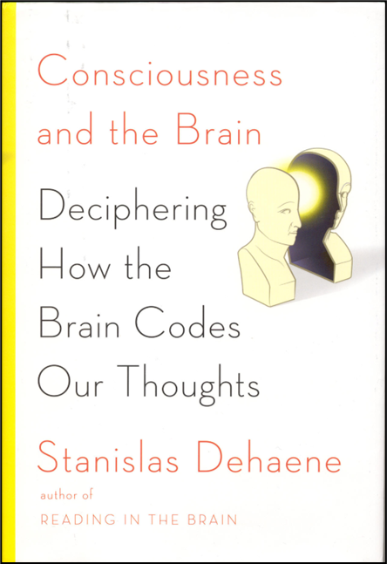

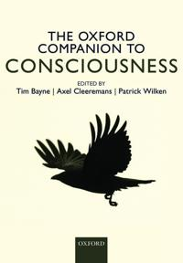
Defining consciousness !?
Consciousness is the individual awareness of your unique thoughts, memories, feelings, sensations, and environments
Essentially, your consciousness is your awareness of yourself and the world around you. (“Verywell mind”**, 2023)
ILAE*-disk.: To be conscious = To comprehend the totality of the situation!
*ILAE: International league against epilepsy
Physicalists:
..and consciousness emerges from physical stuff.
**www.verywellmind.com

Slide 3
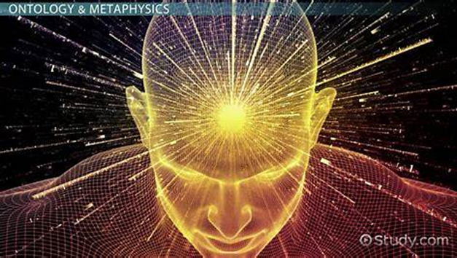
Consciousness gives us «the space of opportunity».
We sense, analyze, describe, feel and remember. Take responsability.
Consciousness has;
1. Level; Vigilans: wakefulness
2. Content; a) Attention /focus
b) Conscious access; test by/ introspection and report!
Language + (subjective experience ( qualia + the art)
Conscious access assumes attention, but not inverted!
In epileptology (ILAE); «to be conscious» (to be aware*):
To comprehend the totality of the situation.
Sensing, self-reflection, context.
*We employ an operational definition of awareness as knowledge of self and environment. Epilepsia 58. Fisher et al. 2017

Slide 4
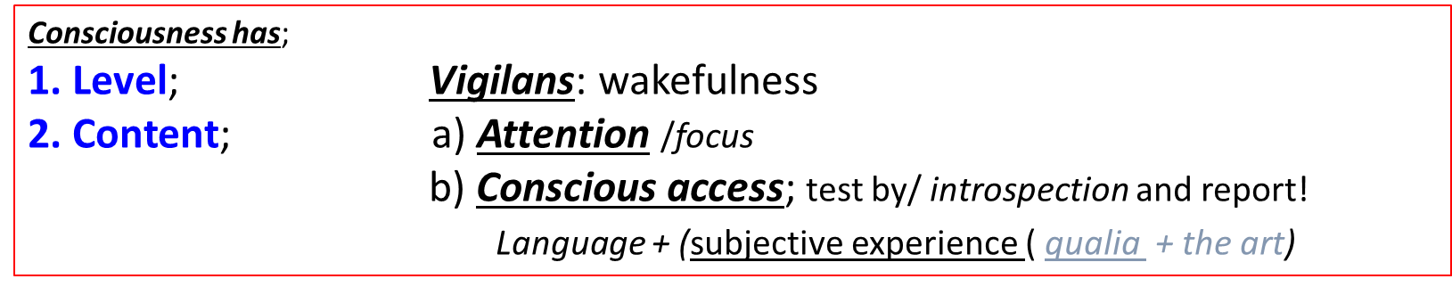
Consciousness.
All conscious experience is: informative and integrated !
(Integrated information theory of consciousness;
IIT. «measured» in Φ (phi). But how?
Information is reduction of uncertainty (mathematically)(ivertion of entropy?) (pertubation complexity index PCI)
Thus, examined by mathematical and statistical methodes ? Phi.
Entropy?

Slide 5

Anil Seth;
For a conscious creature it is somethink it is like to be me !
It feels like somethink to be me ! (p11)*.
Were there is phenomenology there is consciousness.
*having qualia
Norsk: kvalia
BE: (Clinically;) What is consciousness, and
how is it established and regulated?
Subjective phenomenology(qualia) «only» relevant/important for empathy !
but, what about entropy ? (Giske 2024)

Slide 6
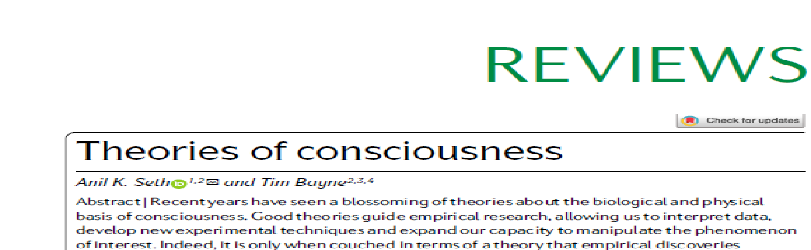

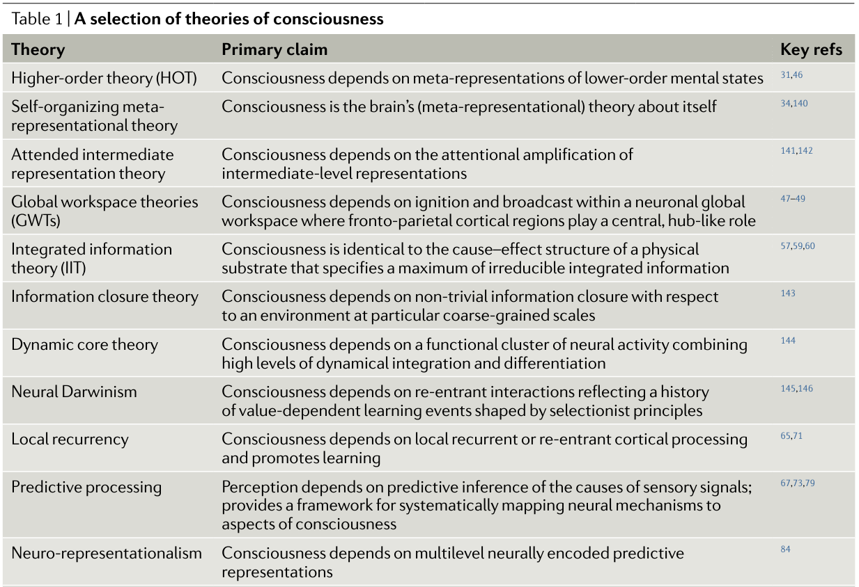

https://www.nature.com/articles/s41583-022-00587-4
May 2022.
N=22
Review 2014 TDNLF

Slide 7
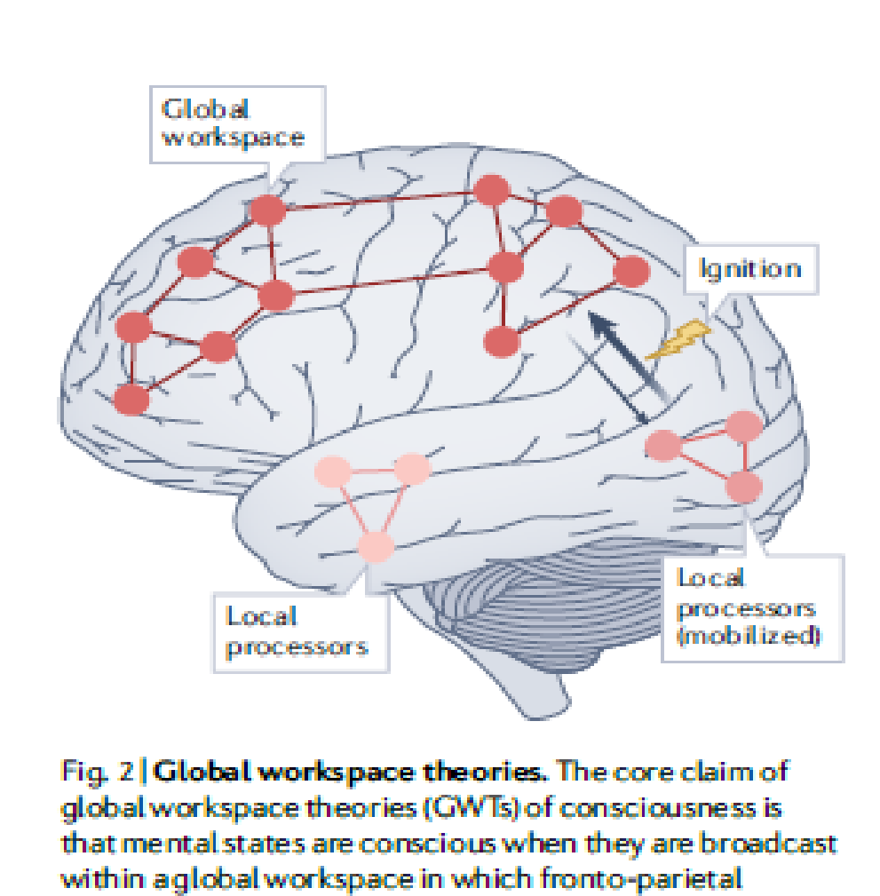

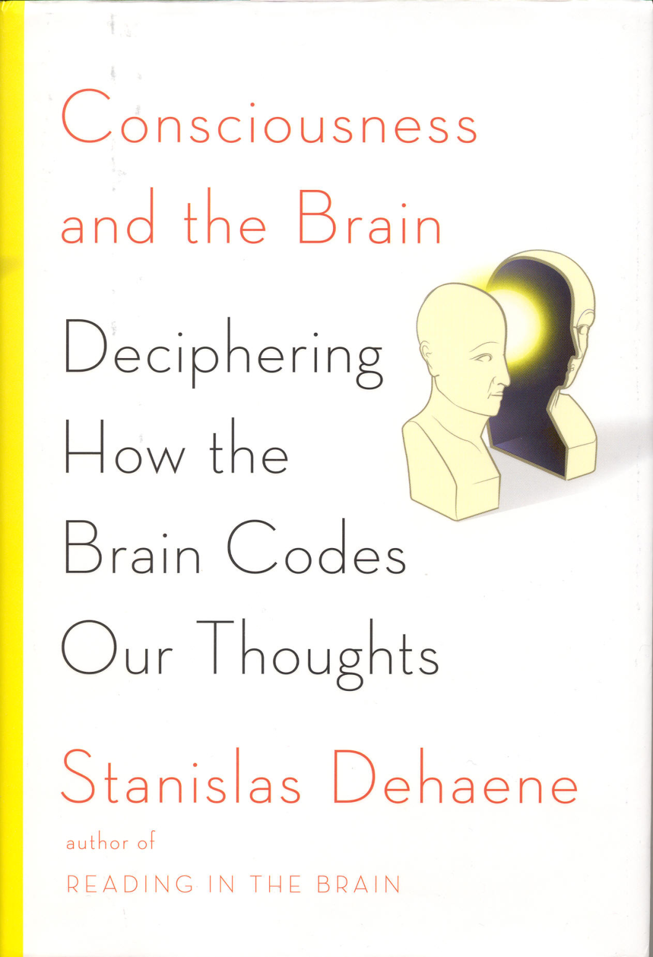
Focus on functional physiological rather than phenomenological aspects.
Tested in humans !
COGNITION!
Attention, evaluation, reflection and verbal response
Global neuronal workspace theory (GNWT).
Frontal lobe + parietal lobe* + + (temp).
Enough to guide flexible behavior and cognition
Monitoring and
metarepresentation
* After ca. 300 msec
Consciousness «signatures»;
Fronto-parietal activation,
P3a/b,
Highfreq. oscillation etc.
Incl. depthelectrodes in
Human brains (N400 in
temporal lobe)
(N2pc; unconscious parietal attention!)

Slide 8


Global neuronal workspace (GNW).
Stimulus;
Sensing,
Emotion
Thought
Memory etc
Frontal lobe + parietal lobe* + + (Temp lobe)
Initiation in GNW assumes;
1. Input from «ignition». (Bottom – up*)
P3a,b
2. Response «reentry» (Top-down)
ϒ-waves & synchronisation
GNW
*with regard to GNW
Information processing in GNW: IIT:
Measure of consciousness. phi. ?
Stanislas Dehaene, 2014.

Slide 9
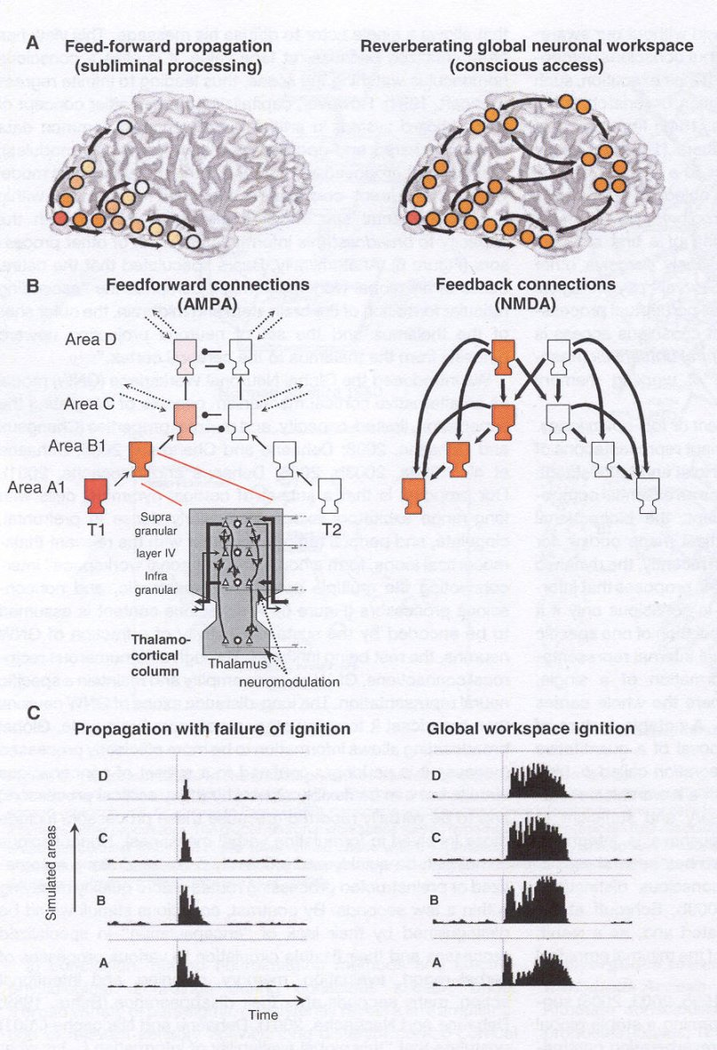
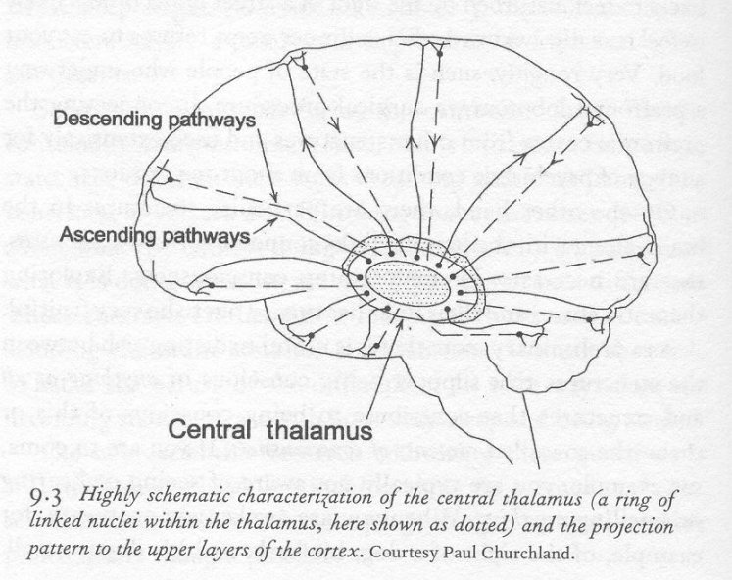
*
*
Important for human SIM (subjectiv internal model)
Giske2024.
Cortex and Thalamus in GNW
«Regional Thalamic activation» !
Dehaene, 2014.

Slide 10
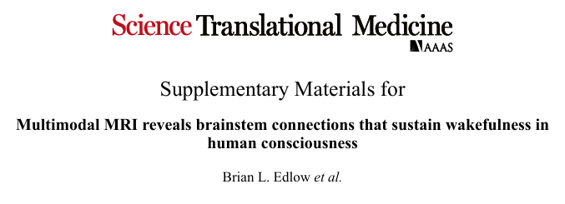
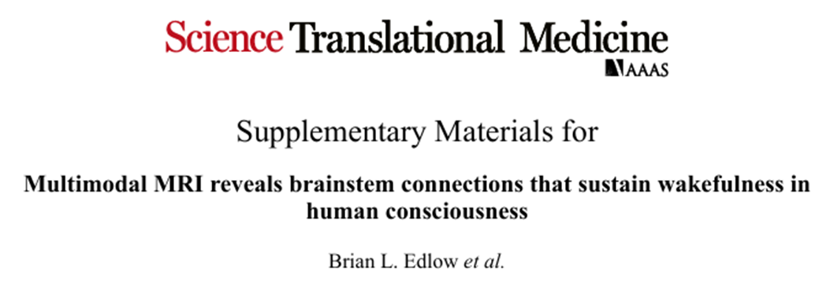
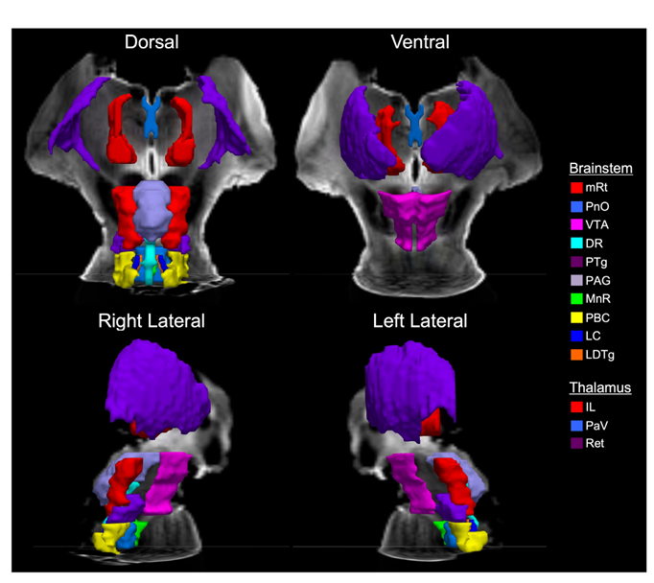
1 May 2024.
Vol.16,Issue 745,
DOI: 10.1126/scitranslmed.adj4303

Slide 11
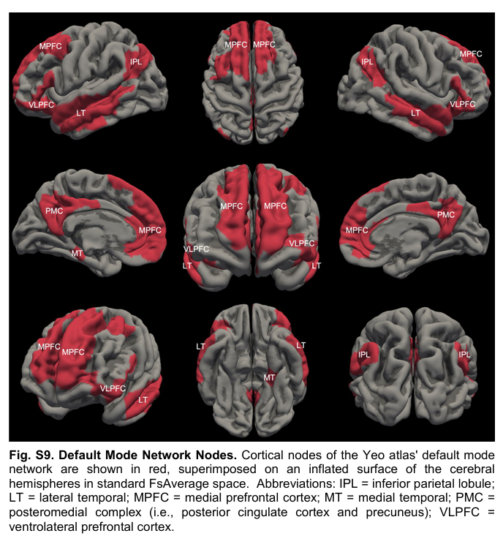
ex vivo diffusion magnetic resonance imaging (MRI) of three human brains, obtained at autopsy from neurologically normal individuals, with immunohistochemical staining of subcortical brain sections. We identified nodes of the proposed default ascending arousal network (dAAN) in the brainstem, hypothalamus, thalamus, and basal forebrain
Deterministic and probabilistic tractography analyses of the ex vivo diffusion MRI data revealed projection, association, and commissural pathways linking dAAN nodes with one another and with DMN nodes.
Complementary analyses of in vivo 7-tesla resting-state functional MRI data from the Human Connectome Project identified the dopaminergic ventral tegmental area in the midbrain as a widely connected hub node at the nexus of the subcortical arousal and cortical awareness networks. Our network-based autopsy methods and connectivity data provide a putative neuroanatomic architecture for the integration of arousal and awareness in human consciousness.

Slide 12
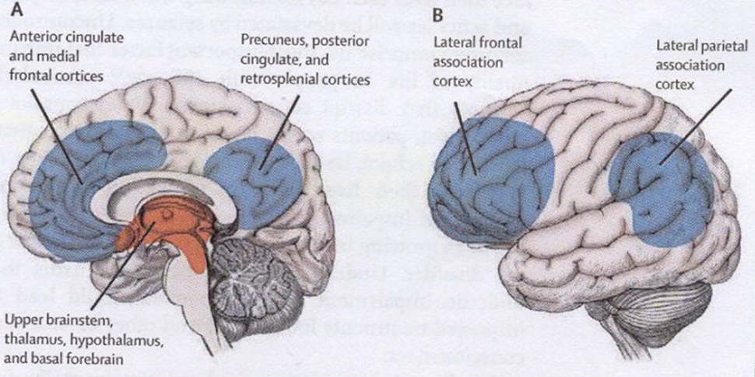
Blumenfelds sugested network versus The Global Neuronal Workspace (GNW).
Time-limited.
Regulated by Thalamus (intralam. nevr. + BS) («regional» thalamic activ?)
Involving activation of front/par & temp cortex. ++ (Cingulum, Precuneus, Insula)
Relevant for epilepsy
FR seizures; Thalamic inactivation with shutdown of fronto-par assoc cortex !
Hal Blumenfeld, 2010 & Chapt.16 Epilepsy & Consciousness, in The Neurobiology of Consciousness, 2nd ed. Academic Press. Pp 255-270. 2016.

Slide 13
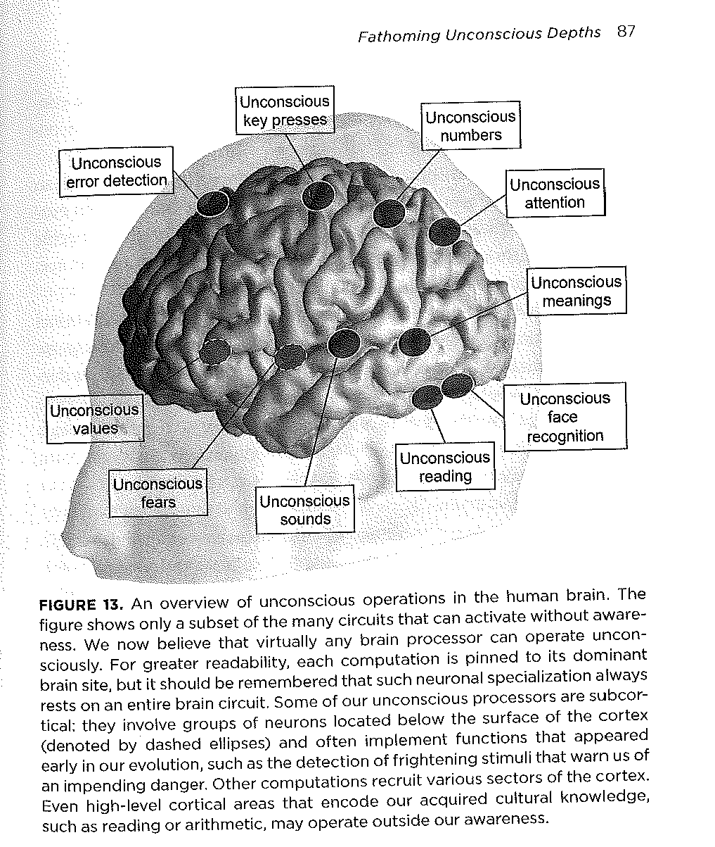
Un-/sub-conscious (subliminal) activated areas in test situations
Almost all parts of the neo- and allocortex can be activated briefly without reaching consciousness. (However, such activation may lead to facilitation!)
Cortikal vs «sub-cortical». No
Fascilitering; unconscious words (< 40 msec)
Prior to a word or motor respons may enhance the speed of a respons.
«Blue»/vs consonants: increased choice of colored «patch» ! NB: meaning!
Stanislas Dehaene, 2014.

Slide 14

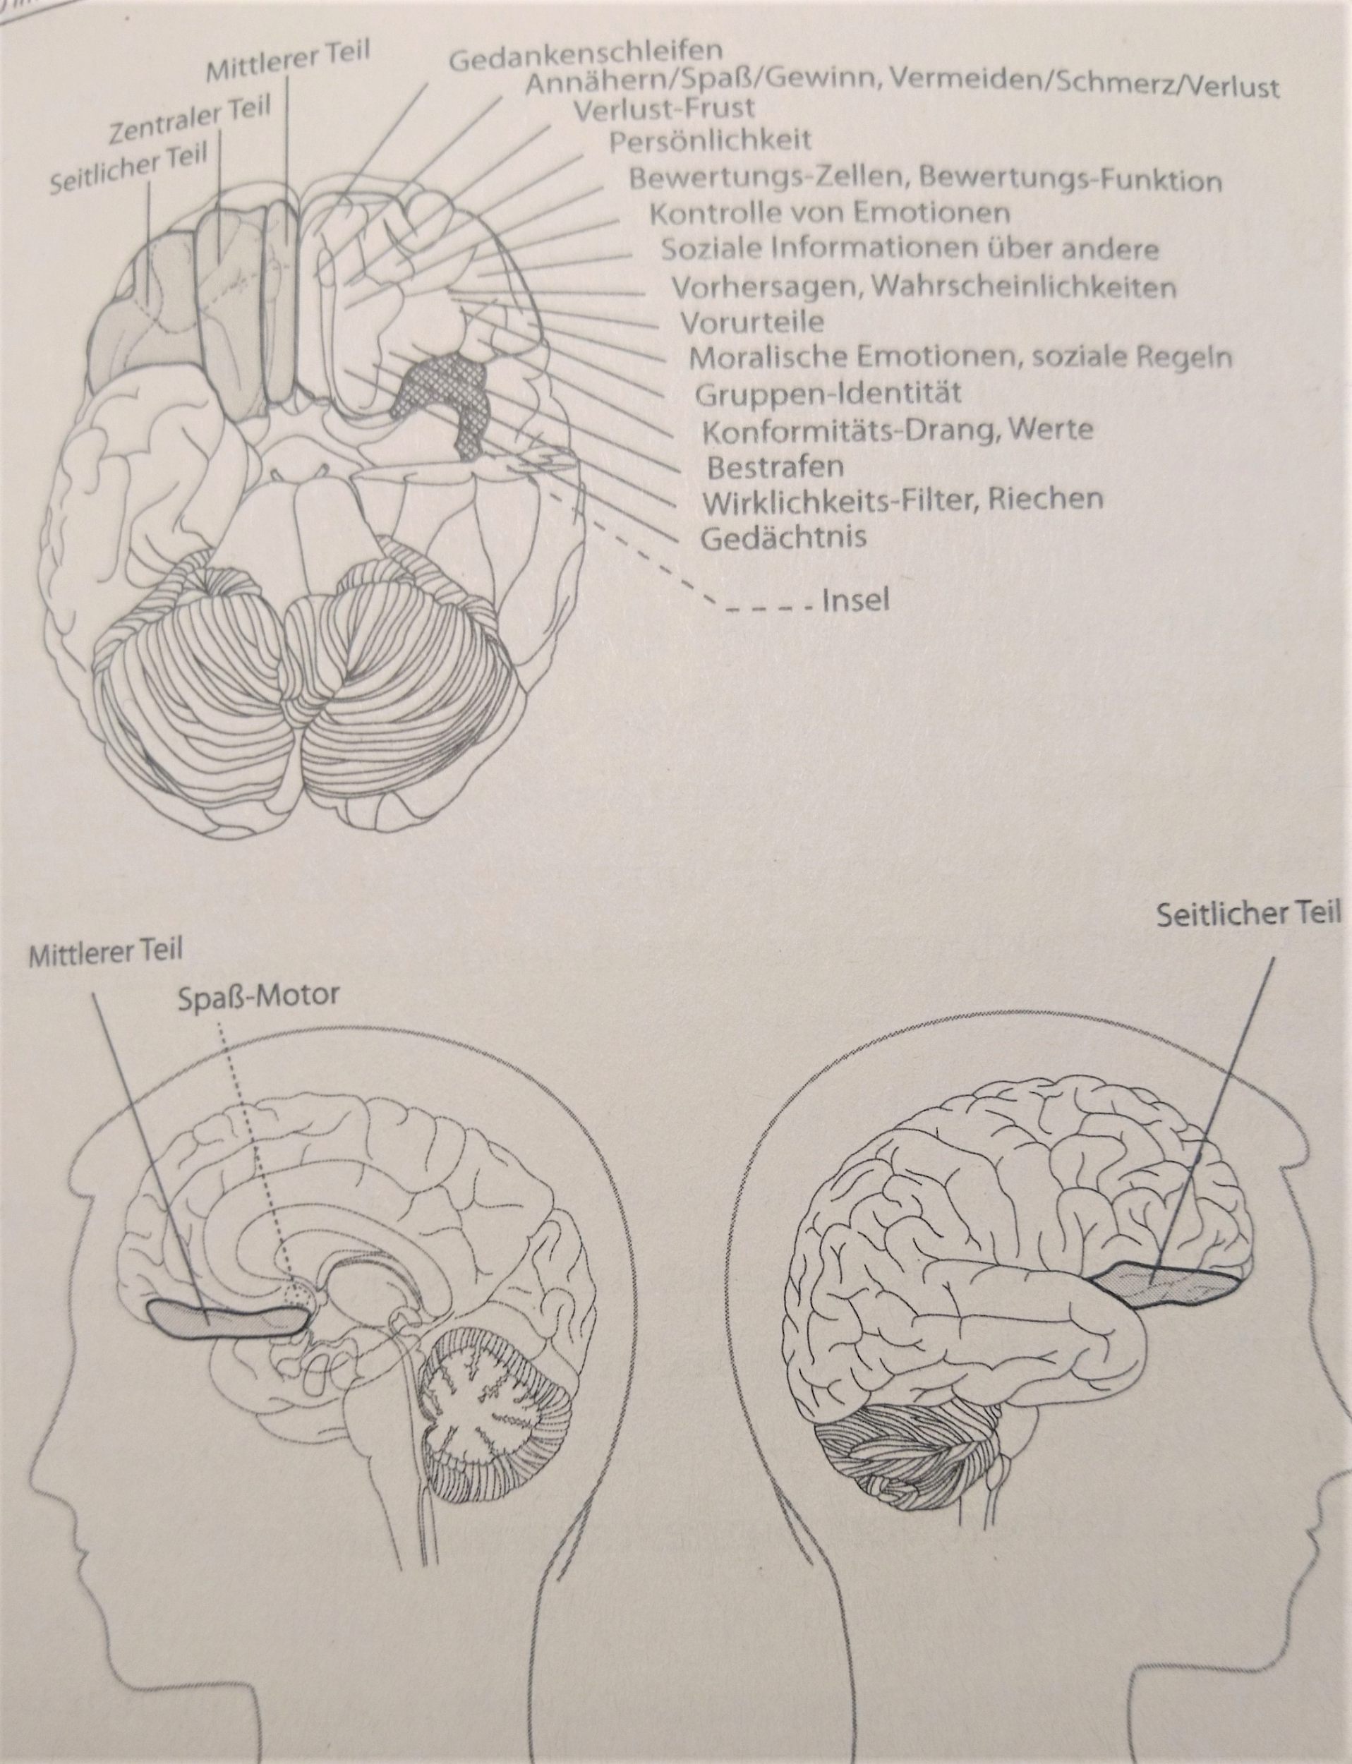
The subconscious importance for behaviour and «normativ biology»!
What is influenced by the subconscious ? motivation! (for wellbeing and behaviour*).
Moral emotions/Social rules etc.
Value systems / evaluations Emotional control
Orbitofrontal cortex
+ vmPFC (BE ☺)
*Jarl Giske et al. 2024,

Slide 15

Values are biologically subconsciously and emotionally (?) «rooted»!
Normativ social influence; rules – normes and «conformation urge/compulsion» are biologically rooted.
Creates motivations and meaning!
Values leads us to maximize wellbeing by behavioral decisions (Giske 2024), but its more complicated in humans than in salmon!
Professor of Law and Philosophy;
«Values are real and fundamental»

Slide 16
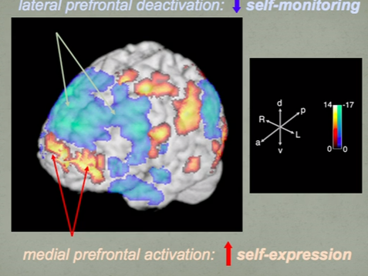
Impaired consciousness during deep sleep.
(slow wave sleep) and hypofrontality !
Resembles the activation pattern and EEG slow wave pattern in NONREM sleep.
However, this illustration pertains to Jazz improvisasjon !
Several studies of consciousness and selfmonitoring /selfexspression reveal impairment in lateral hypofrontality!
JA Hobson & E Pace-Schott. Nat Rev Neurosci. 2002;3:679-
CJ Limb & A Baun; DOI:10.1371/journal.pone.0001679

Slide 17
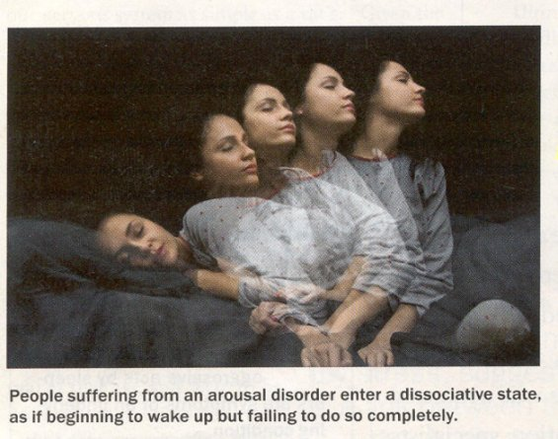
Non-Rem arousal (dissosiativ?) conditions.
Complex behavior in deep sleep
Low frontal activation !
Sleep walking, etc.
Sleep-related violence.
Sleep-eating (4.5% life prev)
Sleep-sex (7.1 % life prev Bjorvatn,2010).
Impaired consciousness = reduced responsibility
www.mind.help/topic/sleep/non-rapid-eye-movement-nrem-sleep-arousal-disorders

Slide 18
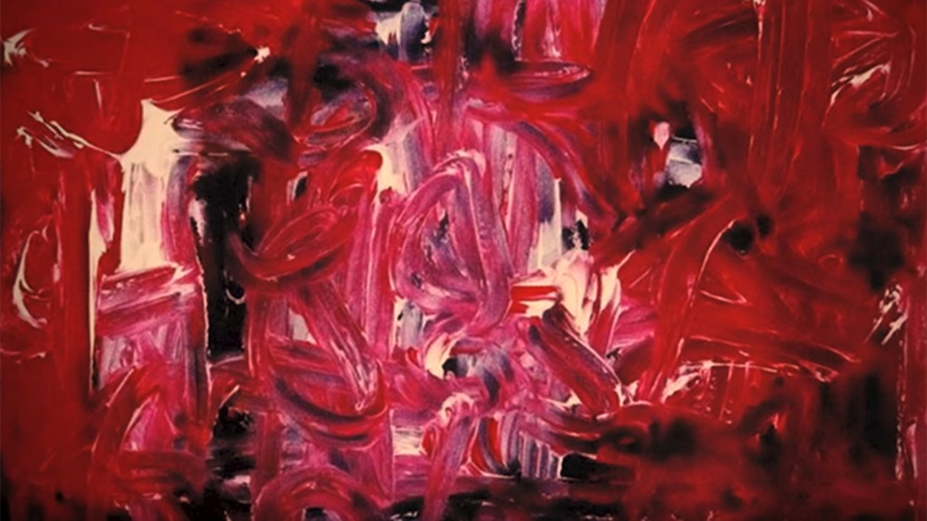

Lee Hadwin has been scribbling in his sleep since early childhood. By the time he was a teen, he was creating elaborate, accomplished drawings and paintings that he had no memory of making – a process ...
2011
https://aeon.co/videos/the-work-of-a-sleepwalking-artist-offers-a-glimpse-into-the-fertile-slumbering-brain

Slide 19
Aware seizures with altered consciousness.
Seizures with «intact» consciousness.

Slide 20
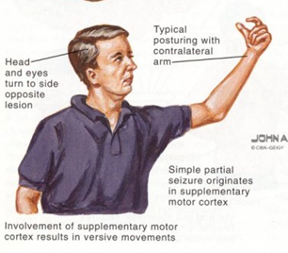
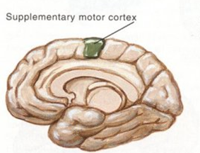
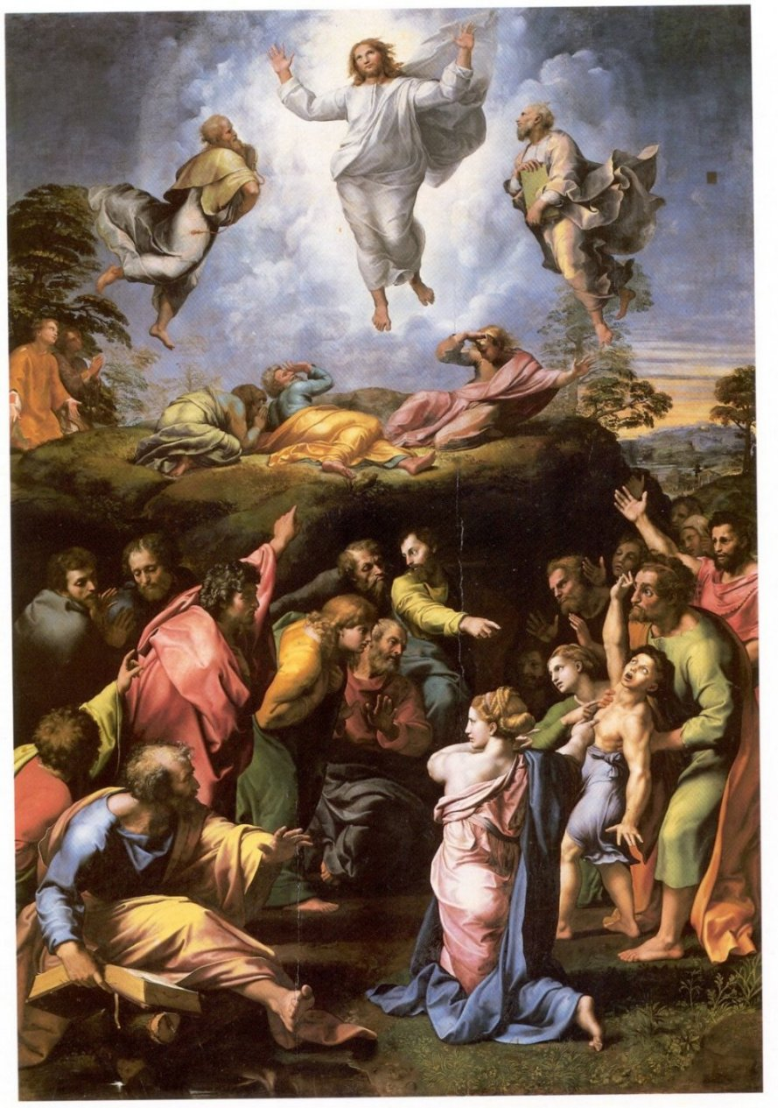
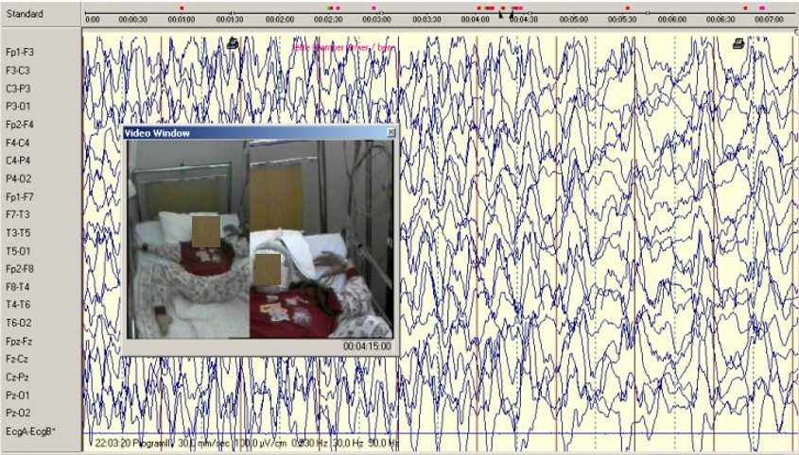
SMC seizure; Frontal midline seizures.
Transfiguration 1520
b.1987, 10 yrs. 2004; seizure free
Conscious, but not willed !

Slide 21
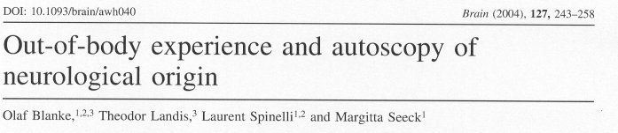
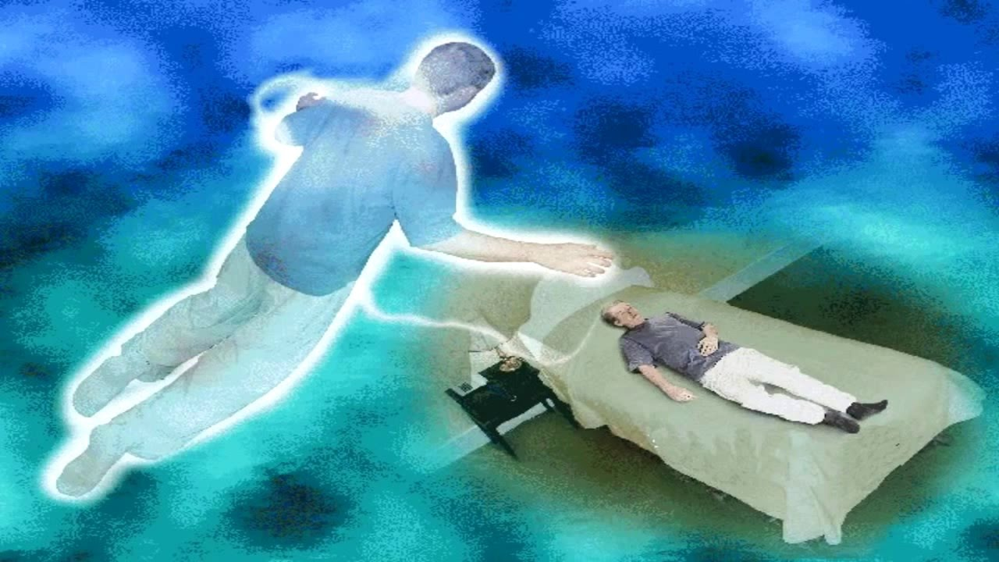
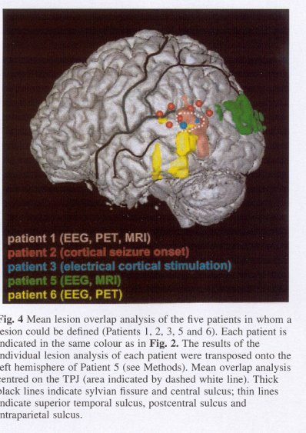
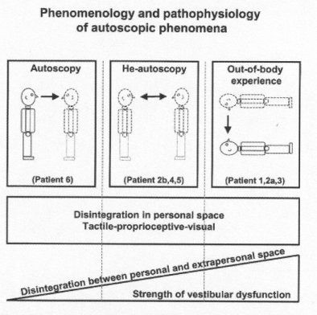
Right & left
All had epilepsy

Slide 22
Epilepsy is an episodic condition/dysfunction wich fills consciousness with unwanted content and meaning.
Seizure symptoms and context are often attempted understood !
Our brain is a hypothesis generator!

Slide 23
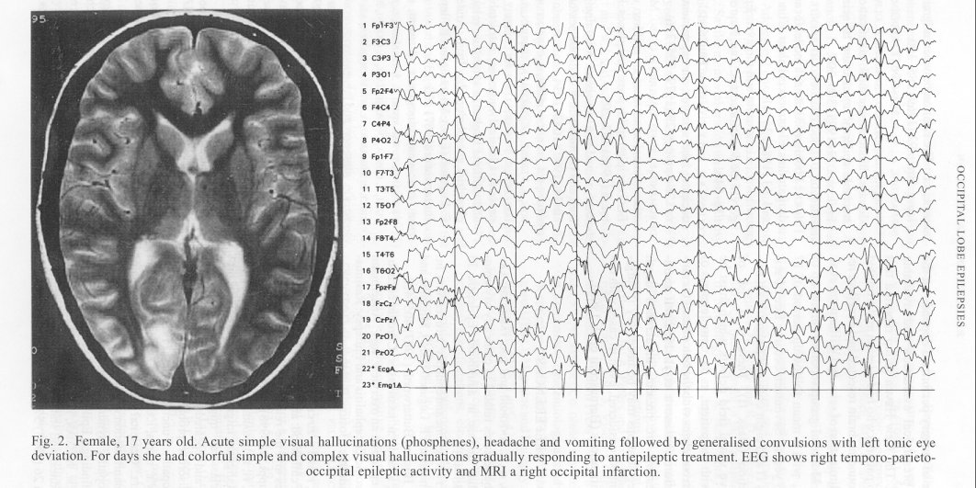
X♀; Seizures with longlasting simple and complex visual hallucinations and headache and vomiting. Status epilepticus. Early in the course small green men occured.
Another POLG patient; flashing lights, intens feelings, confusion, and ictal/postictal blindness for over a week.
JA Aarli and BA Engelsen. Occipital lobe epilepsies. Meinardi, ed. Handbook of Clinical Neurology, 2000; vol73 (29):107-115.

Slide 24
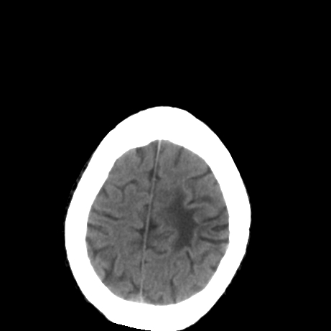
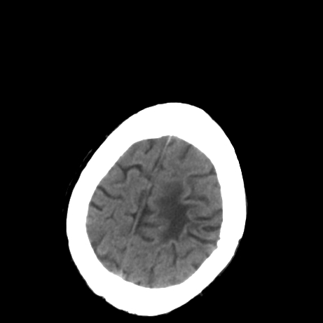
Man, b. 72. In 1995 FTC seizure, and seizure with fascial clonic movements, «numbness» in the nose and feeling of «something in the nose» !
On a tour in England he experienced ”thoughts forced upon him” assosiated with anxiety, feeling of impending death and a feeling the head should explode. Several episodes of forced thinking ! Sometimes partly impaired consciousness.
Right spastic hemiparesis.
Dangerous and evil thoughts!

Slide 25
Seizures with impaired consciousness.

Slide 26
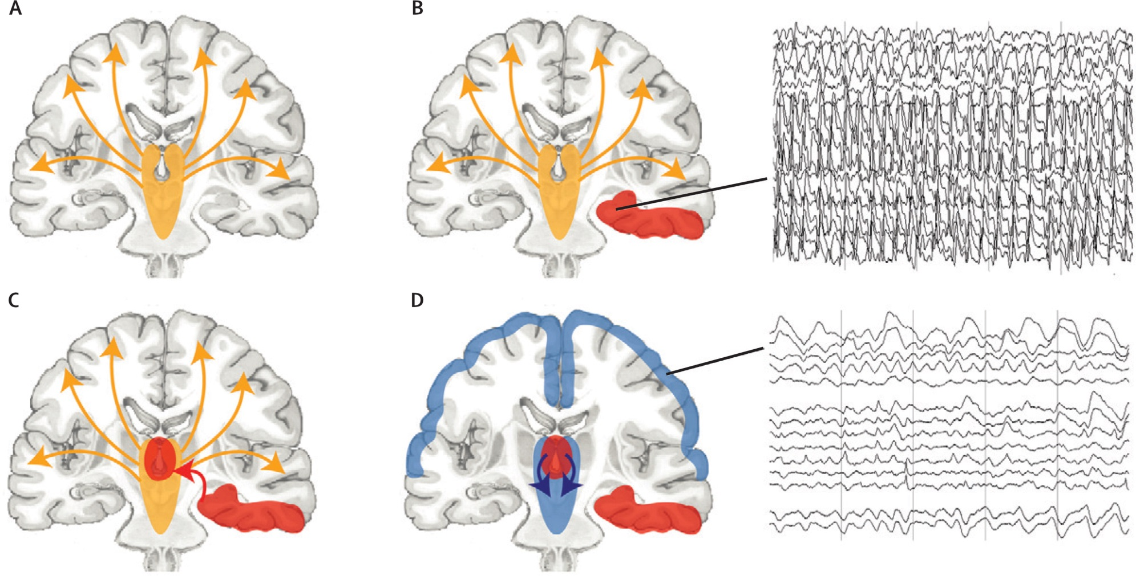
Impaired consciousness in epilepsy!
↑ activ
↓ activ
Hal Blumenfeld.
Lancet Neurology. 2012;11

Slide 27
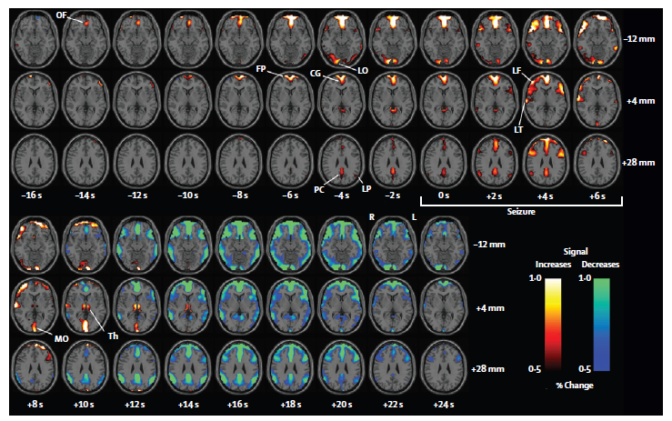
↓ Seizure ↓
Epilepsy and
Impaired
consciousness.
51 seiz. mean 6.6 sec
Before absence; Frontopolar / medial frontal cortex activation
During absence: Frontal association/lat cortex activation
After absence; Significant neocortical hypoactivity; cognition?
Loss of consciousness due to activation/epil. activity
Blumenfeld Lancet Neurol.2012:11:814-26

Slide 28
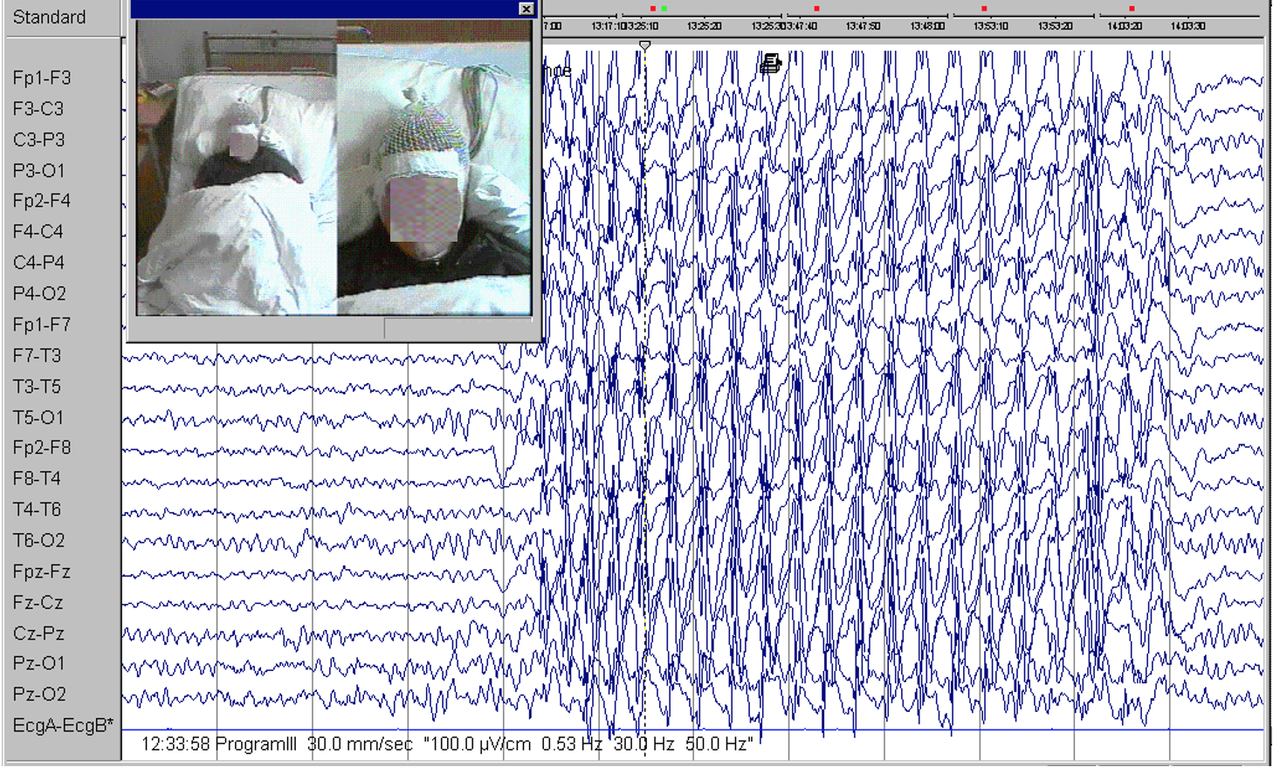
Generalised spikes and «possible absence»

Slide 29
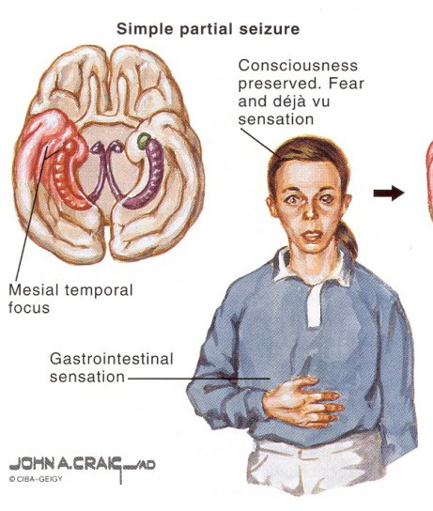
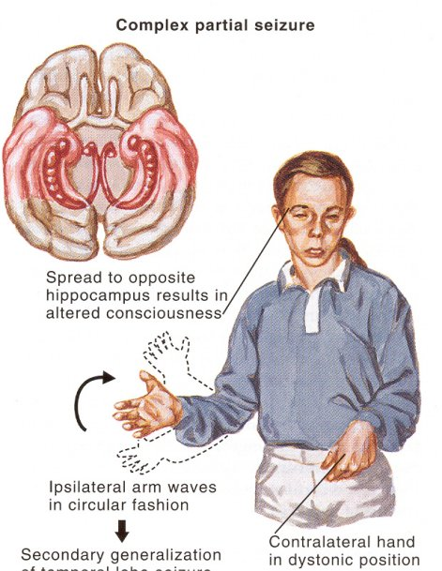
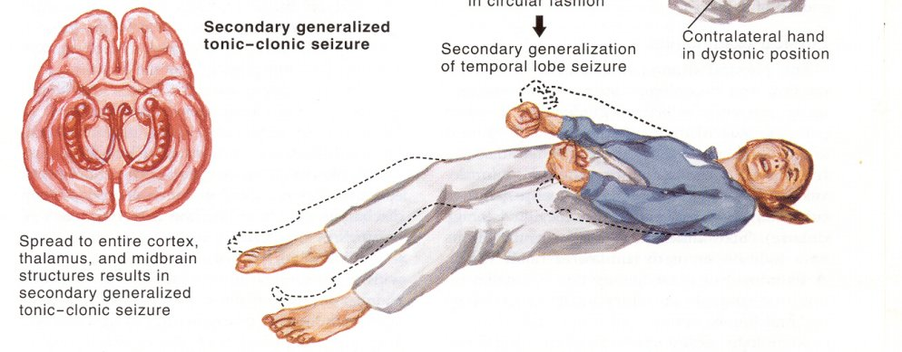
Temporal lobe seizures
?
Thalamus and FP cortex

Slide 30
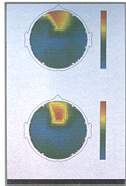
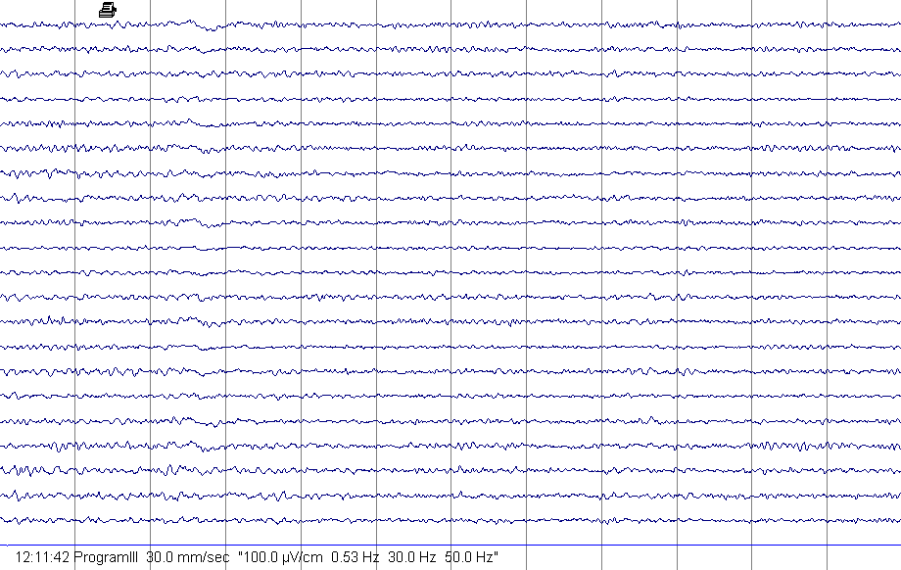
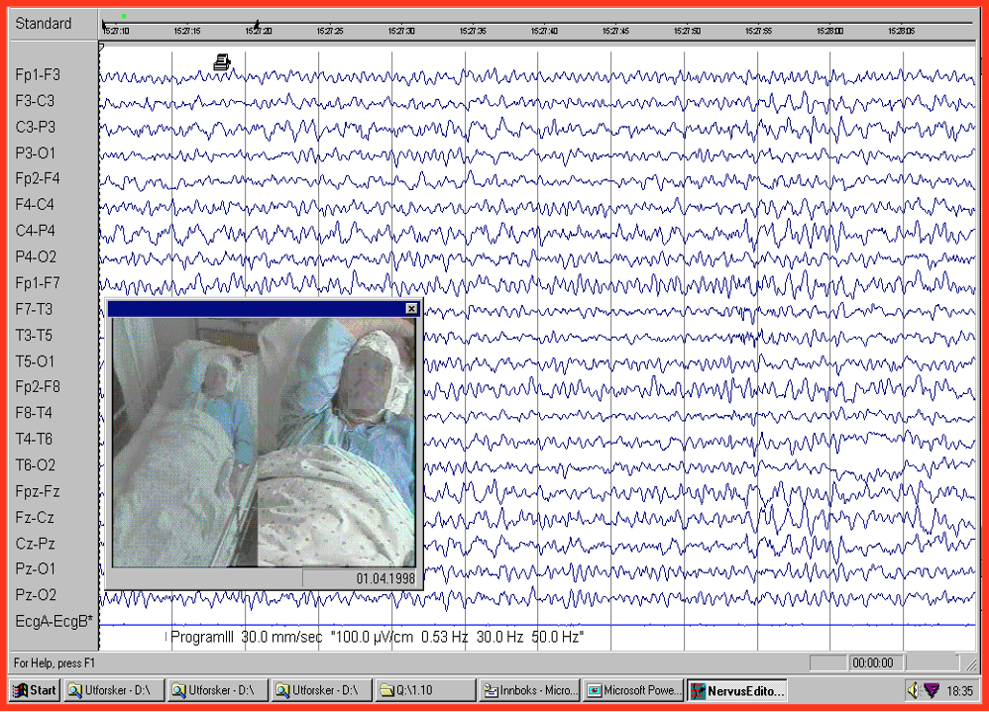
Normal (a) og ictal (b) EEG of patient B, 79 yrs.
Seizures with confusion and speach problems from 1993. 1994 psychiatr. clin (depression/psychosis)? CBZ+DPH (cognitively impaired!) Diagnosed as dementia?
AED stopped.
At arrival in 1999; normal MMS 29.
Each week for 5 years ca. 2 episodes of 24-48 hrs duration with confusion, afasia, unrest and urine retention starting during sleep.
a
b

Slide 31
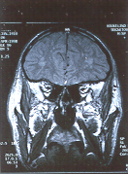
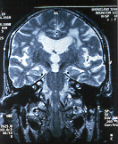
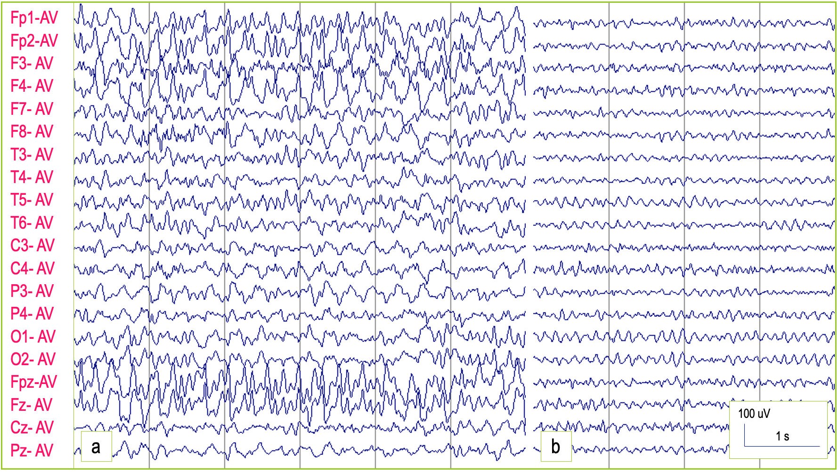
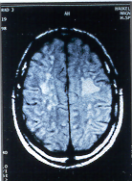
NCSE in patient B, 79 yrs.
Karlsen B, Engelsen B, Lillebø A, TDNLF 2000.

Slide 32
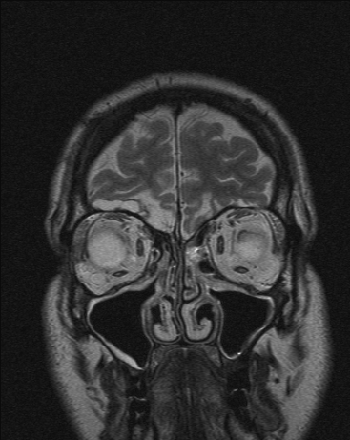
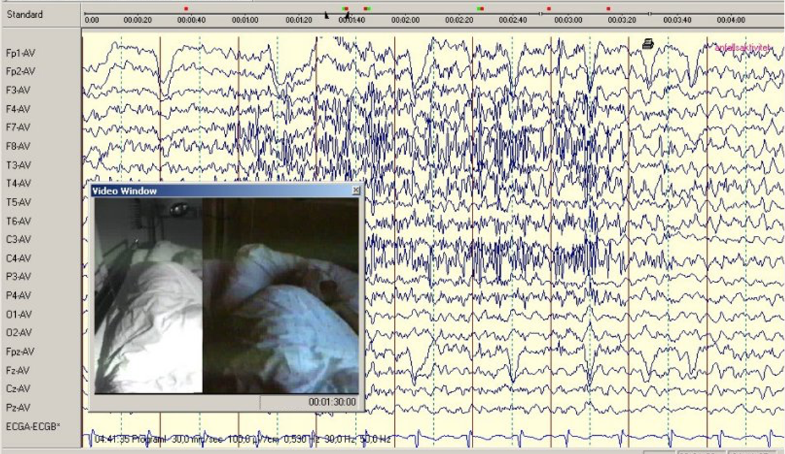
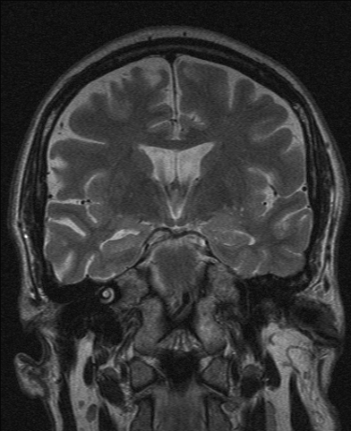
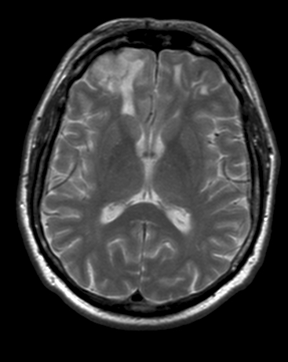
Shoo-peer from Loddefjord.
FR seizure during sleep with minor clinical symptoms, right hand automatisms and postictal confusion.

Slide 33
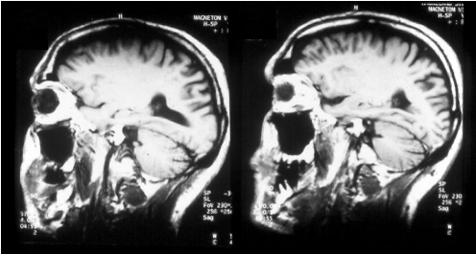
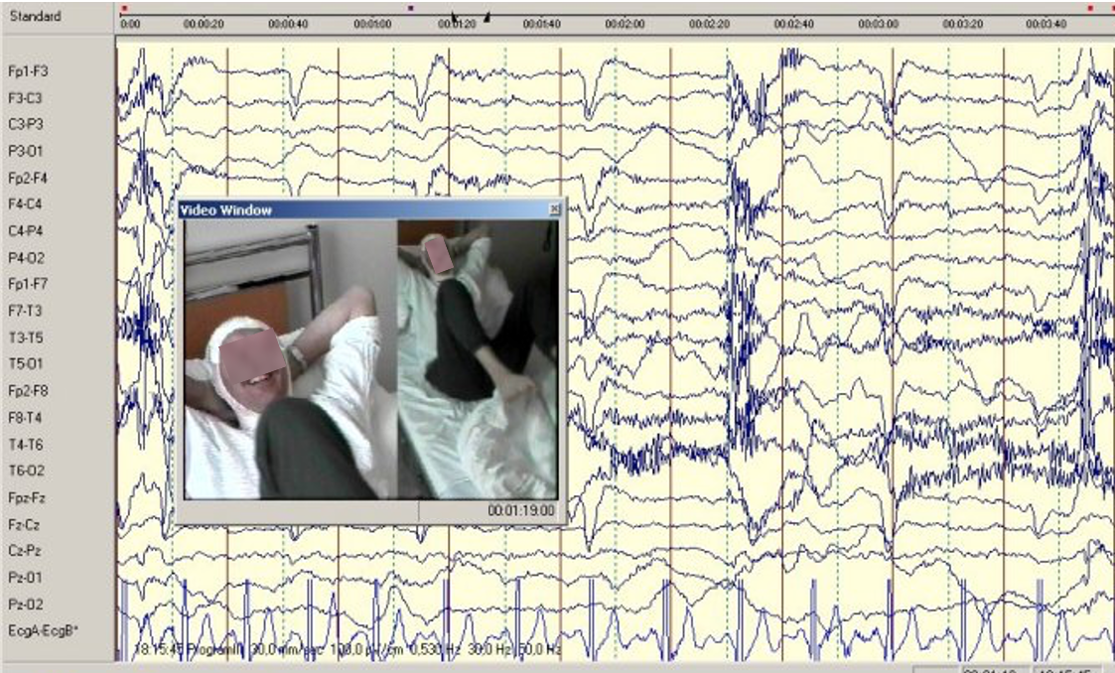

”Having a good laugh”; impaired consciousness.
Bilat.(right>left) Hipp.sclerosis

Slide 34

FR seizure with smile and short laughter.
Left hippocampal sclerosis Postoperative seizure free.
V

Slide 35
Seizures with fractionated consciousness. Dissociation !

Slide 36




2021. Am J Psychiatry.178:2:
Dissociation is a disconnection between a persons thoughts, memories, feelings, actions and sense of self.
↑ amygd. aktiv
Increased coactivation of the control FPN (CEN), «ruminating» DMN and altered cooperation with the Salience (viktighets) networks.
Betwixt 2. Rachel Elise 2014.

Slide 37


Dissociation = changed activation pattern!
2021
Activated
network connections
Activated regions
Am. J. Psychiatry 2021

Slide 38

«Fragmentation of self » and out of body feeling in epileptic seizure. Dissociation.
Jennifer Hall
Transcending
From the Storm; Artists with temporal lobe epilepsy. 1993.
Slide for free use.

Slide 39

Juliane Ahrens, 1996.
Seizures like a dream.
Dissociation !?
Something conscious, something «fuzzy»
Slide for free use.

Slide 40
Seizures with «enhanced» or intensified consciousness.
Enhanced self experience &
Feeling of meaning/truth & clearity +
Altered perception of time

Slide 41




Front Behav Neurosci: doi.10.3389/fnbeh.2016.00021.
Sizures with:
*Intense happiness; «Bliss, clarity, serenity»
*Intensified self-awareness and experience
of the suroundings and clarity.
*Meaning + truth ! Intensely felt values
Right > Left ?
Antero-dorsal Insula
AD Craig. The sentient self. Brain Struct Funct.2010:563-577.

Slide 42




♀
b. 1921
1990.
♀ 64 år.
Had "been in heaven" and often saw Jesus.
♀ 53 yrs.

Slide 43




 b.64. Car accident 7-8 år old. Loss of consciousness
Epilepsy from age 16. FTK, FB/FR w/religious feelings and thoughts.
EEG under the feeling of being i heaven
1989
EEG 1 min a 5 mg DZP iv

Slide 44

Reduced parietal activation during meditation with a feeling of «going up into something greater outside oneself»
Der Spiegel.

Slide 45

Patient C, woman 60 yrs
First attack in 1992 (age 52). She wakes up with a headache that worsens with physical activity, nausea and gets better within 24 hours. Eventually problems organizing thoughts and actions (for example, paying the correct amount in a shop). (Dyscognitive seizures!).
Karlsen B, Engelsen B, Lillebø A. TDNLF, 2000.
Treated with Lamictal + Orfiril.

